Slide 1

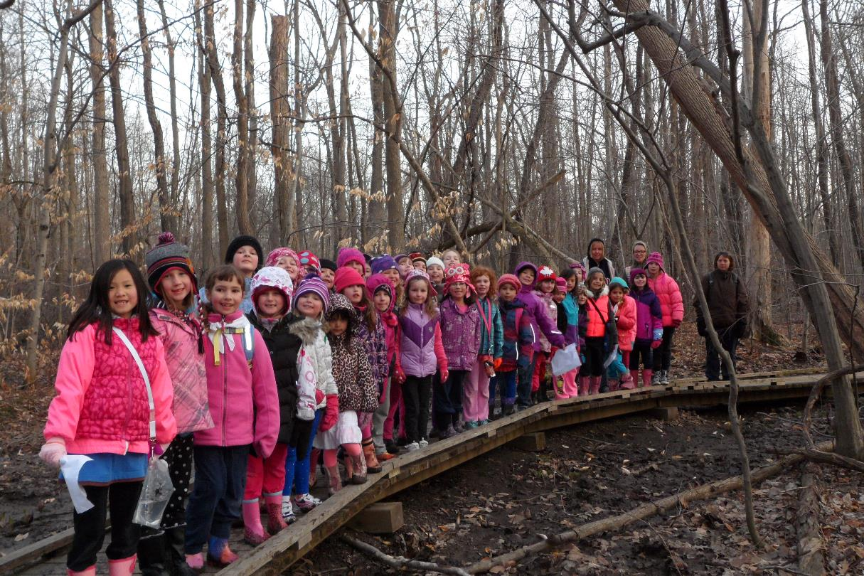
Advancement Ceremony
May 8, 2014
NOTE:
To change images on this slide, select a picture and delete it. Then click the Insert Picture icon
in the placeholder to insert your own image.
1st Waterdown Guides
4th Waterdown Brownies
1st Waterdown Sparks

Slide 2
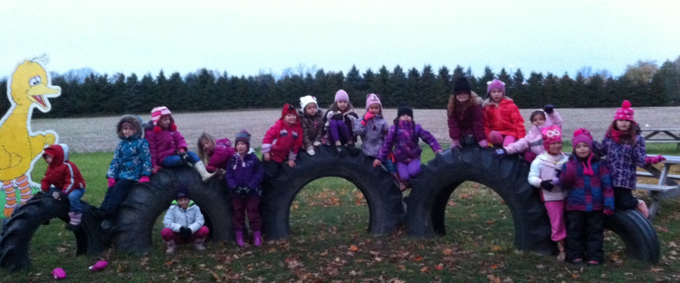
Fun at Parkside Farm
NOTE:
To change images on this slide, select a picture and delete it. Then click the Insert Picture icon
in the placeholder to insert your own image.
1st Waterdown Sparks

Slide 3

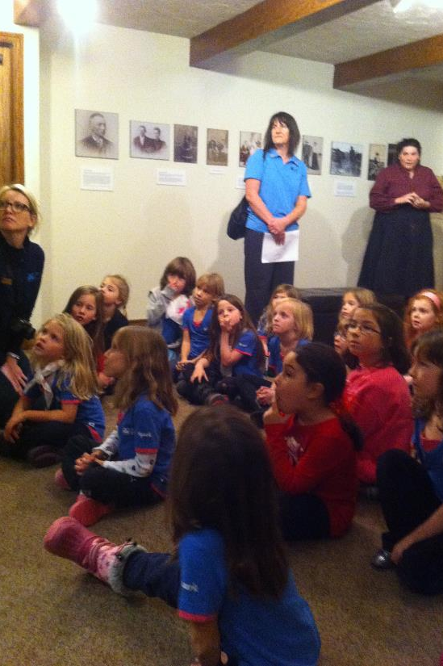
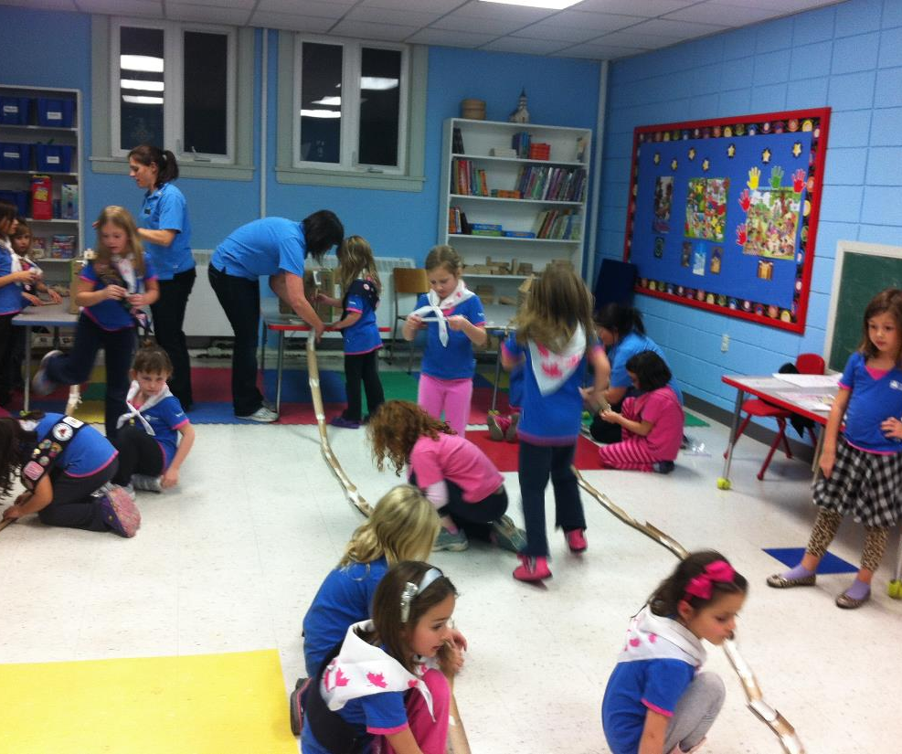
NOTE:
To change images on this slide, select a picture and delete it. Then click the Insert Picture icon
in the placeholder to insert your own image.
Ireland House
Construction Site

Slide 4

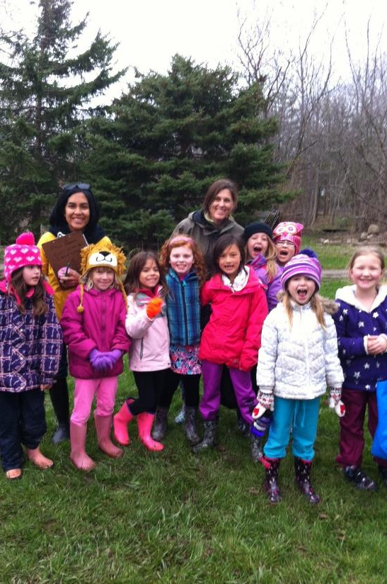
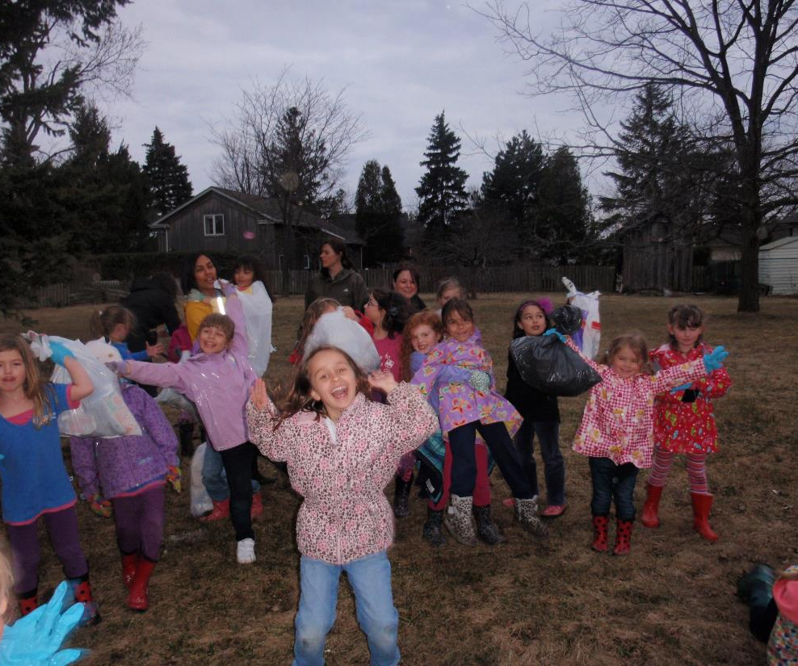
NOTE:
To change images on this slide, select a picture and delete it. Then click the Insert Picture icon
in the placeholder to insert your own image.
2nd Years’ Hike
Litter Pickup

Slide 5
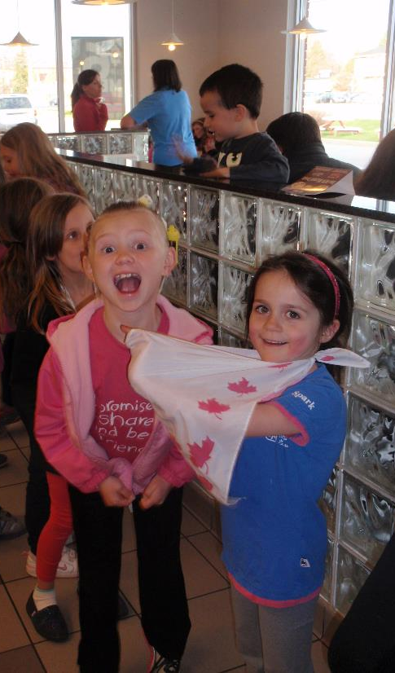
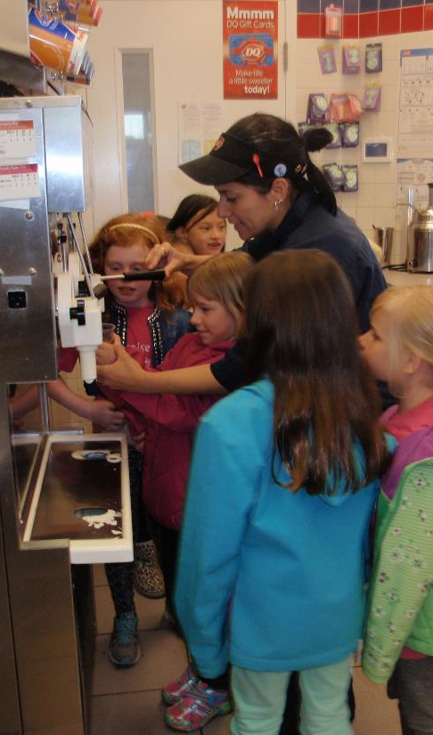
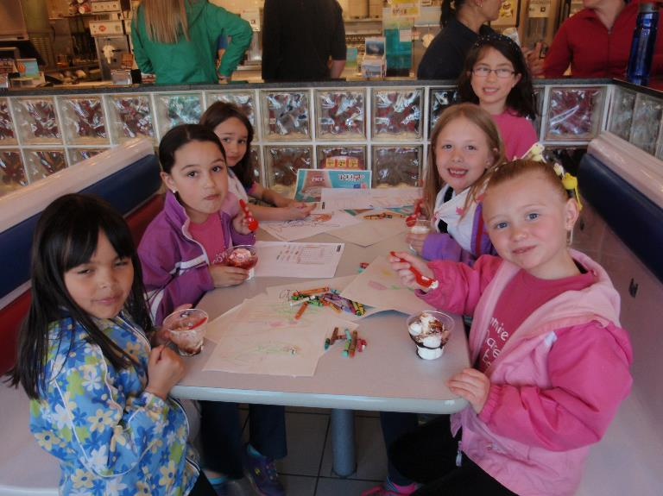
NOTE:
To change images on this slide, select a picture and delete it. Then click the Insert Picture icon
in the placeholder to insert your own image.
Making Ice Cream Sundaes
at Dairy Queen

Slide 6
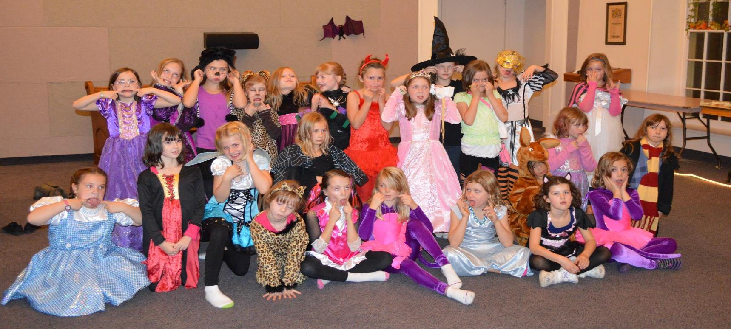
Halloween Party Sleepover at Knox Church
4th Waterdown Brownies
NOTE:
To change images on this slide, select a picture and delete it. Then click the Insert Picture icon
in the placeholder to insert your own image.

Slide 7
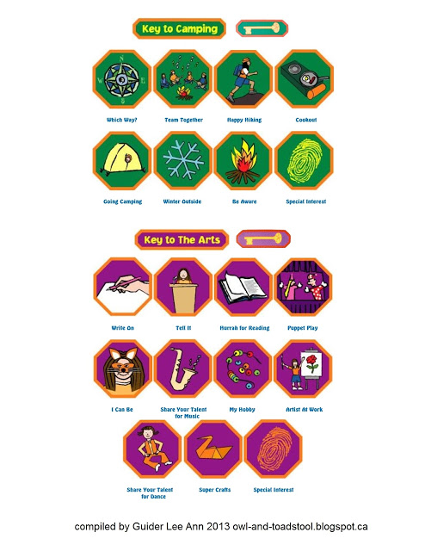
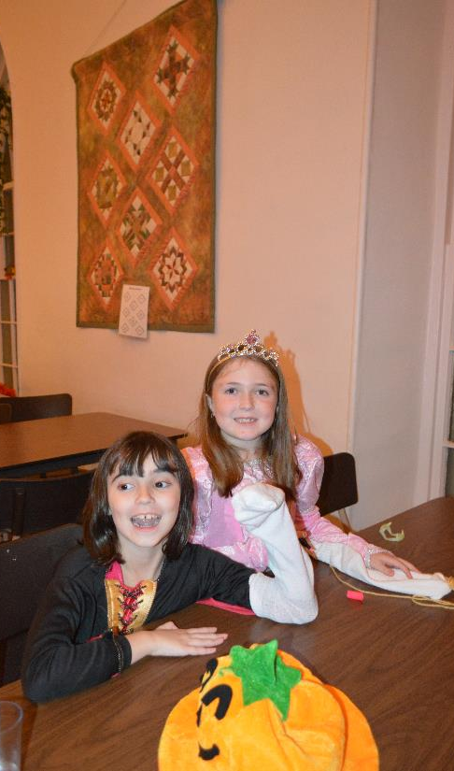
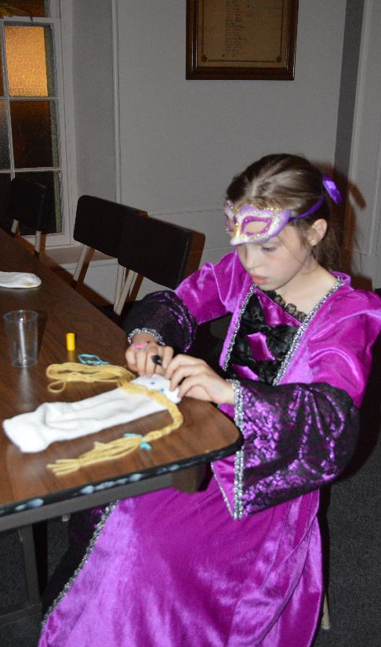
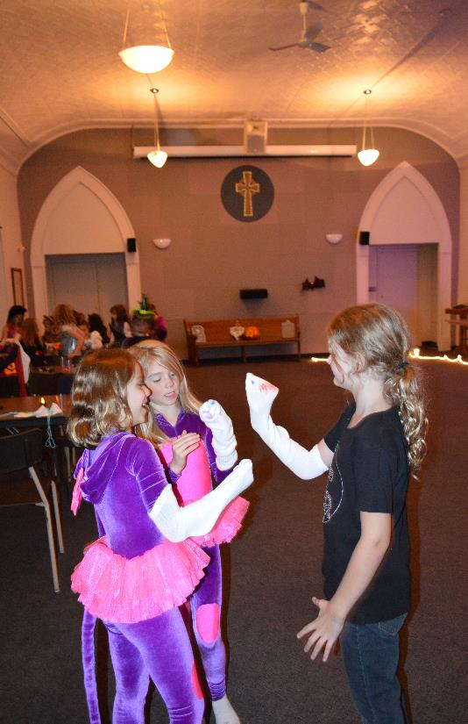
NOTE:
To change images on this slide, select a picture and delete it. Then click the Insert Picture icon
in the placeholder to insert your own image.
Making Sock Puppets and Presenting Puppet Show

Slide 8
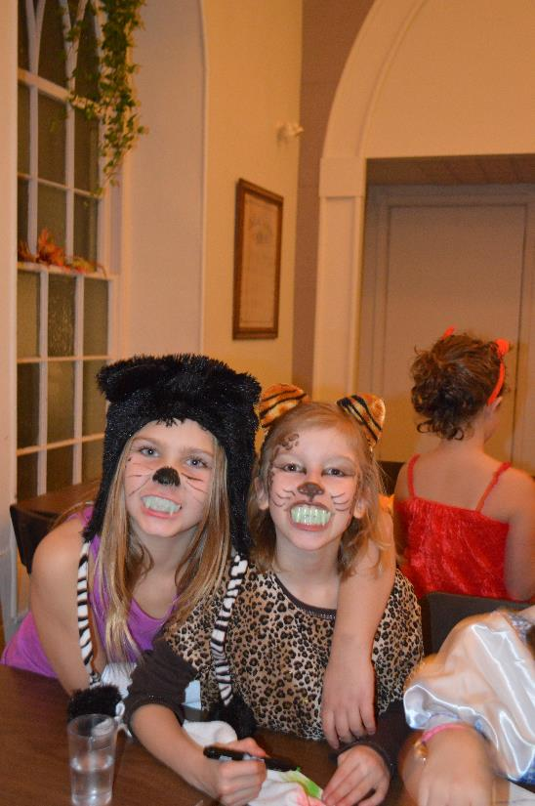
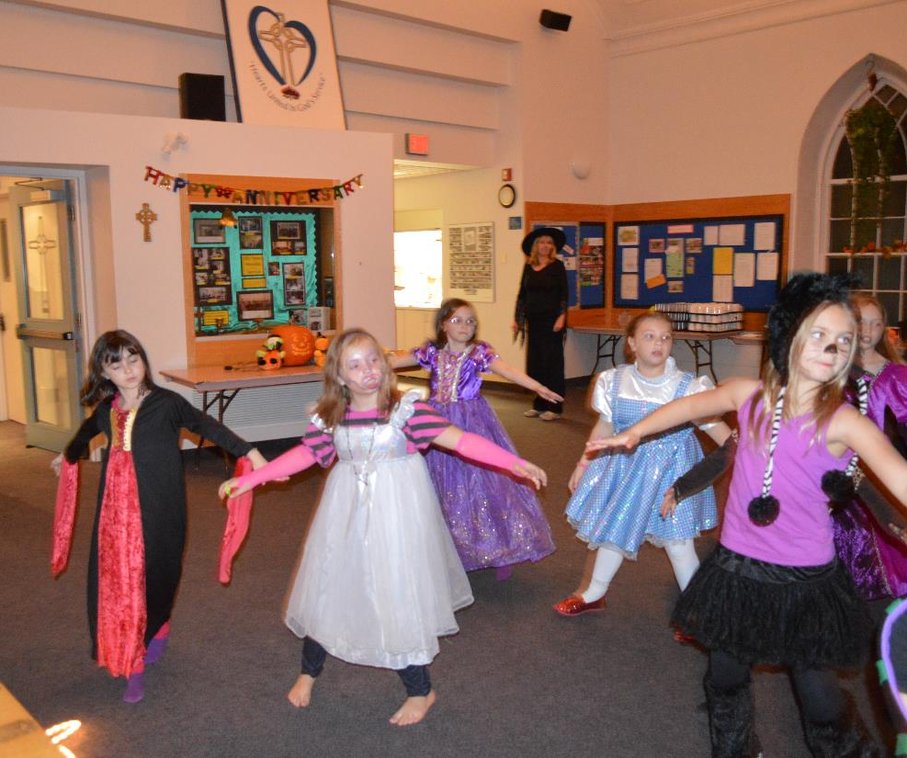
NOTE:
To change images on this slide, select a picture and delete it. Then click the Insert Picture icon
in the placeholder to insert your own image.
Learning a Halloween Dance “Ghost Busters”

Slide 9

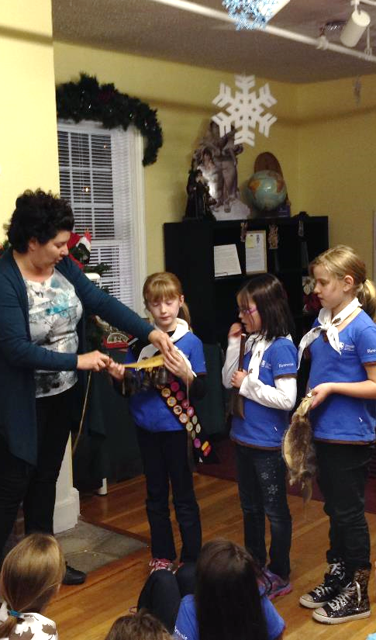
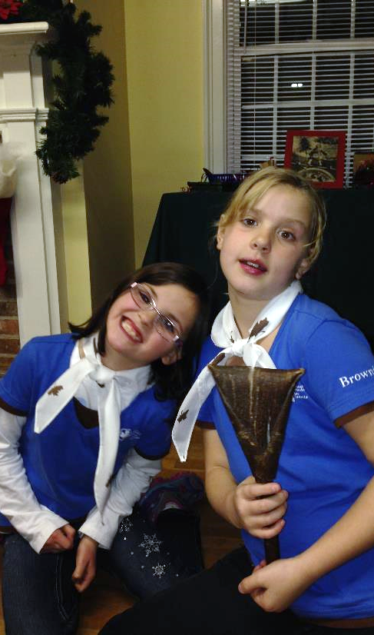
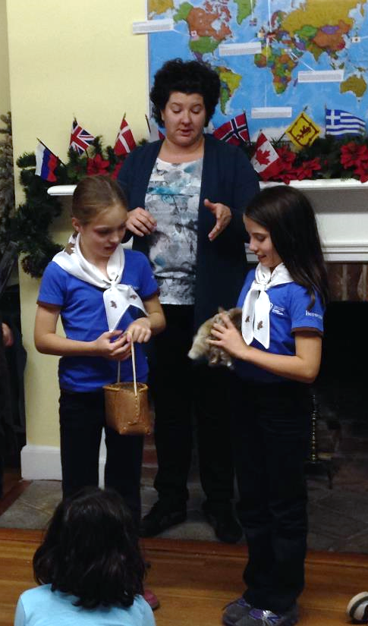
NOTE:
To change images on this slide, select a picture and delete it. Then click the Insert Picture icon
in the placeholder to insert your own image.
Joe Brant Museum – Exploring Aboriginal Artifacts

Slide 10

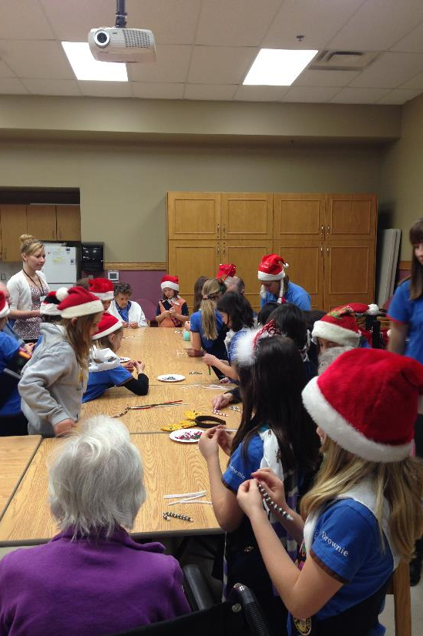
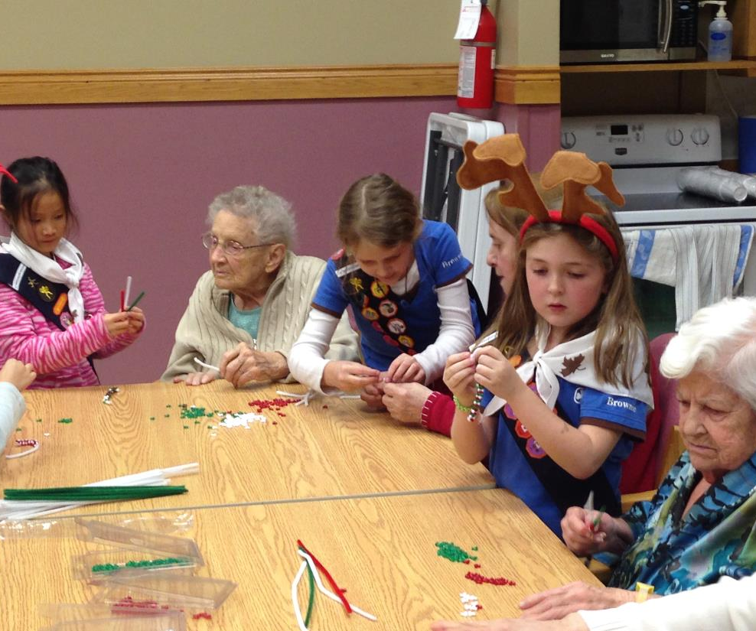
NOTE:
To change images on this slide, select a picture and delete it. Then click the Insert Picture icon
in the placeholder to insert your own image.
Alexander Place - Christmas Crafts and Caroling

Slide 11
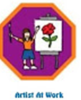
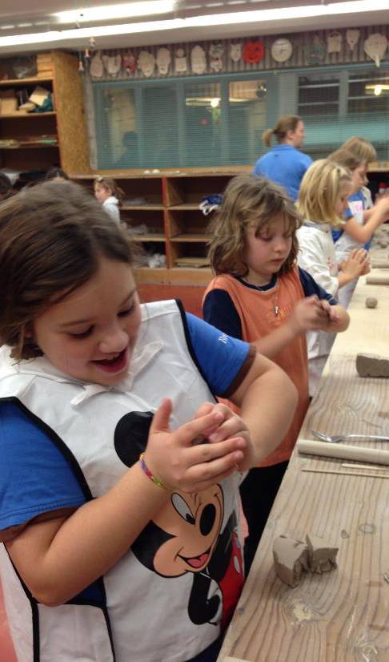
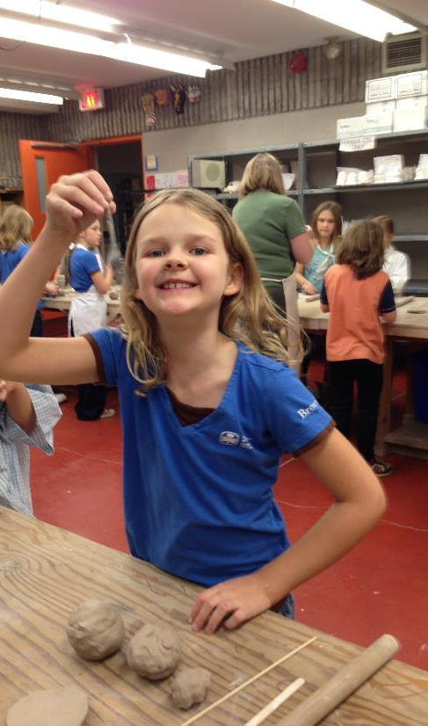
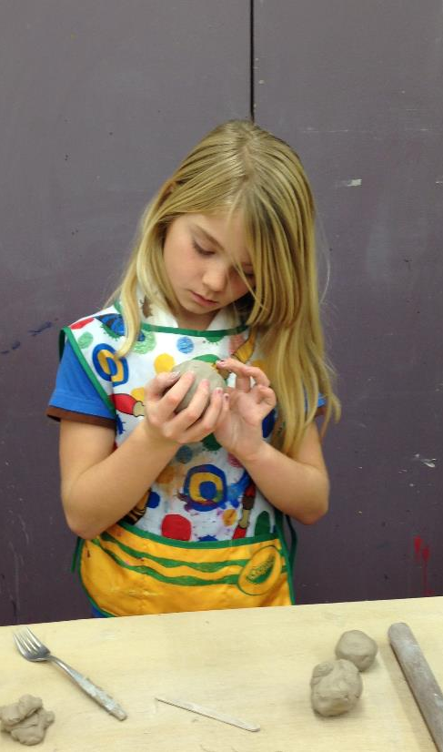
NOTE:
To change images on this slide, select a picture and delete it. Then click the Insert Picture icon
in the placeholder to insert your own image.
Burlington Art Centre – Making Clay Snow Friends

Slide 12
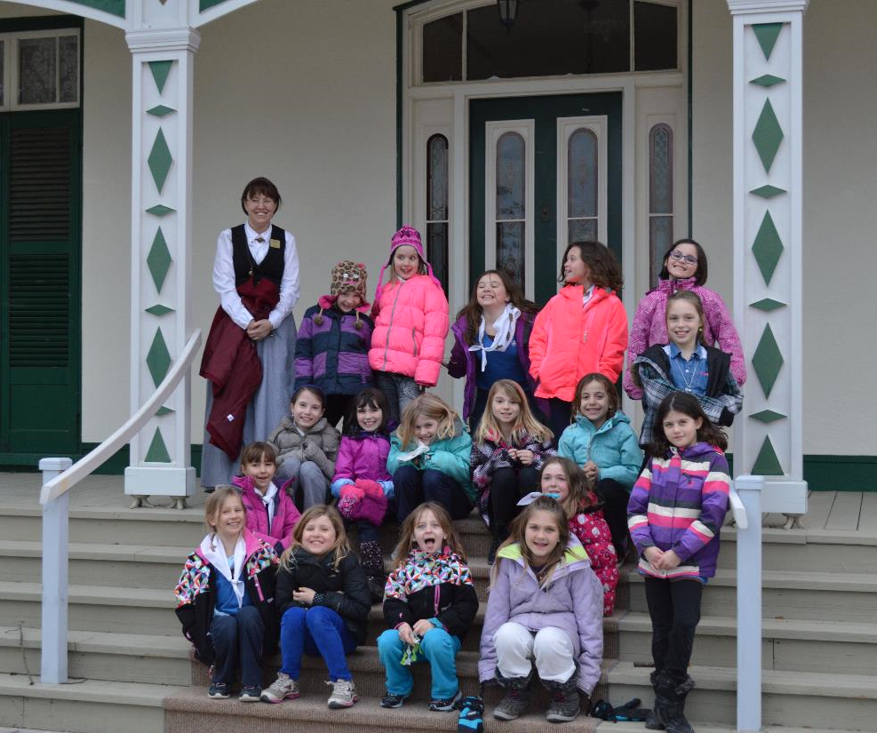
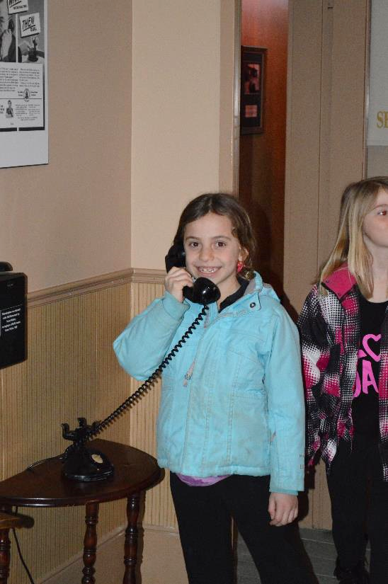
NOTE:
To change images on this slide, select a picture and delete it. Then click the Insert Picture icon
in the placeholder to insert your own image.
Bell Homestead Museum Sleepover, Brantford

Slide 13
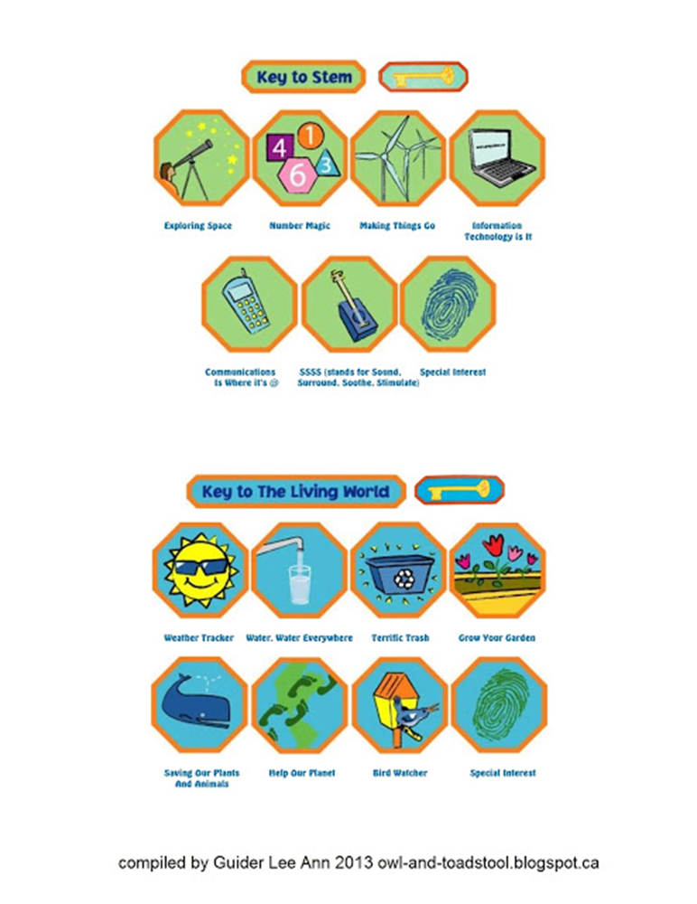
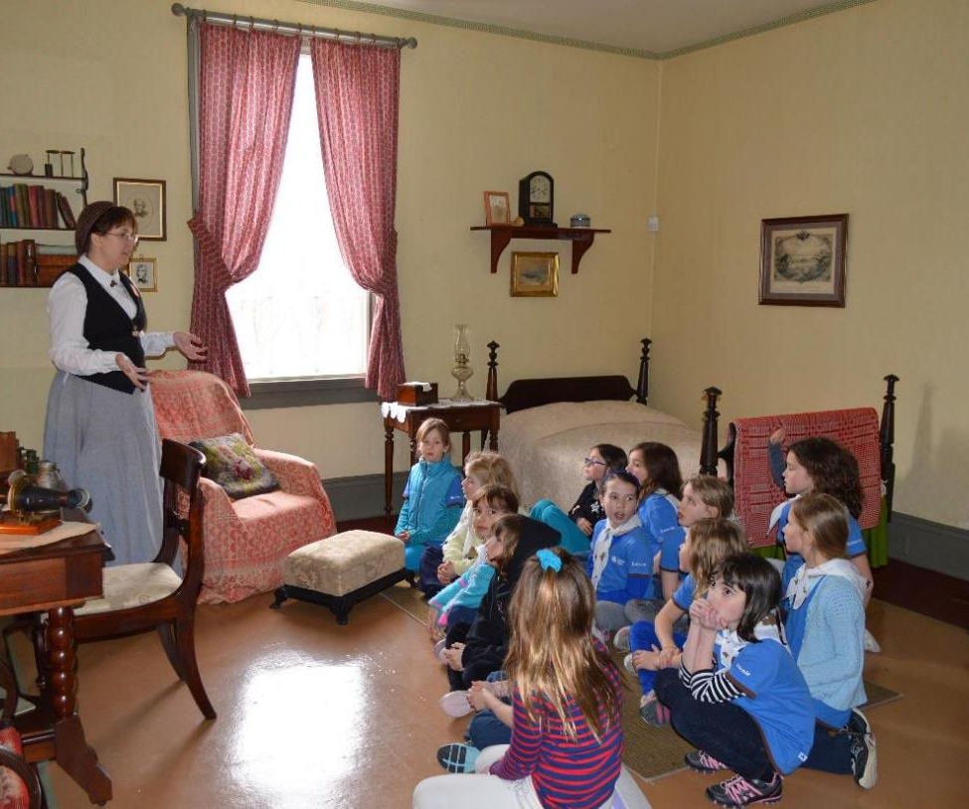
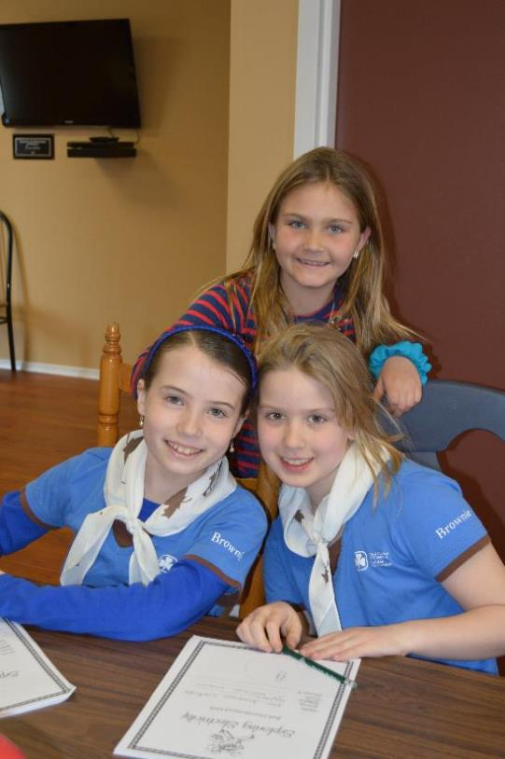
NOTE:
To change images on this slide, select a picture and delete it. Then click the Insert Picture icon
in the placeholder to insert your own image.
Bell Homestead
Tour of House and Experiments with Sound

Slide 14
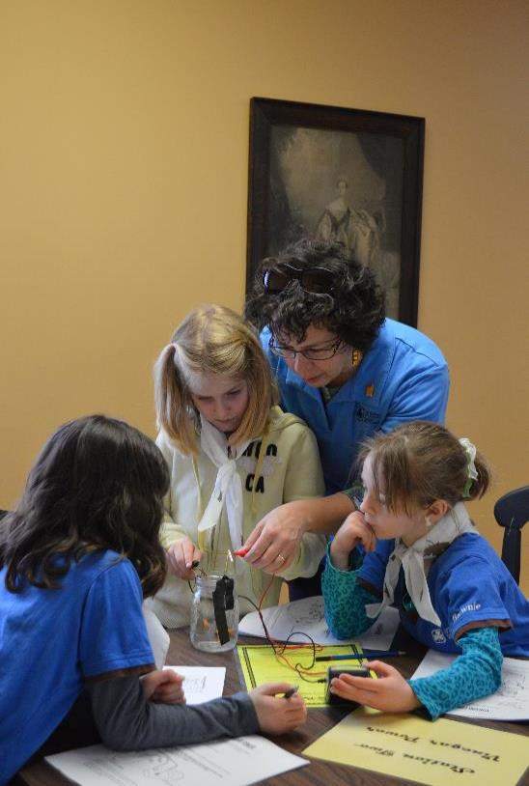
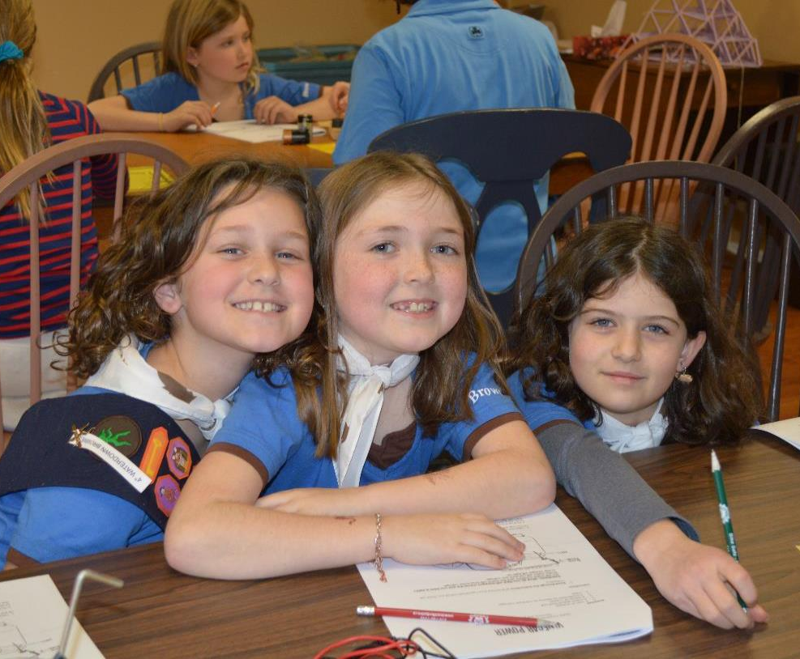
NOTE:
To change images on this slide, select a picture and delete it. Then click the Insert Picture icon
in the placeholder to insert your own image.
Bell Homestead
Experiments with Electricity, Batteries and Motors

Slide 15
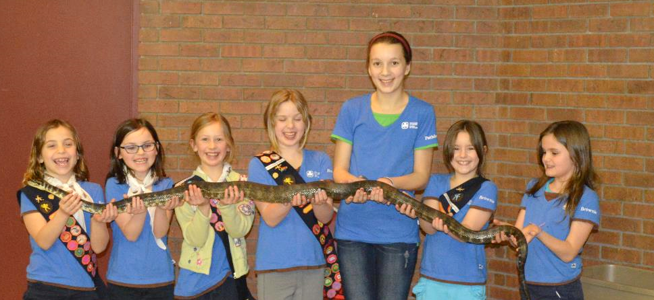
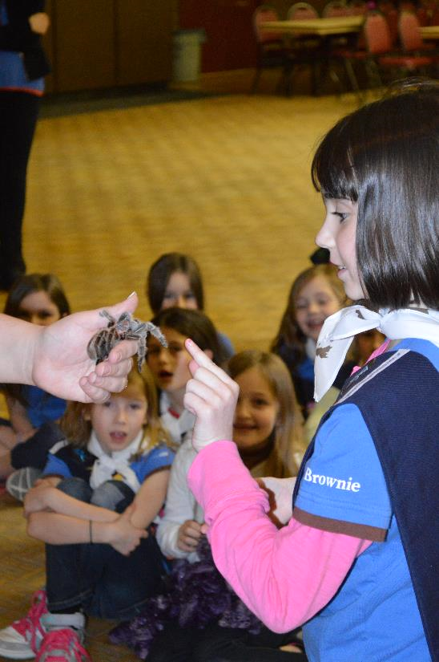
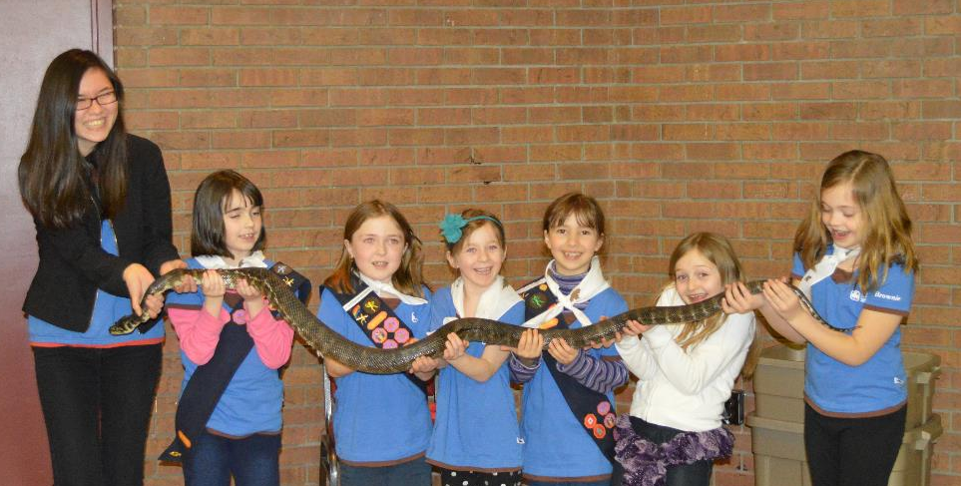
NOTE:
To change images on this slide, select a picture and delete it. Then click the Insert Picture icon
in the placeholder to insert your own image.
Snakey Stacey Visit

Slide 16
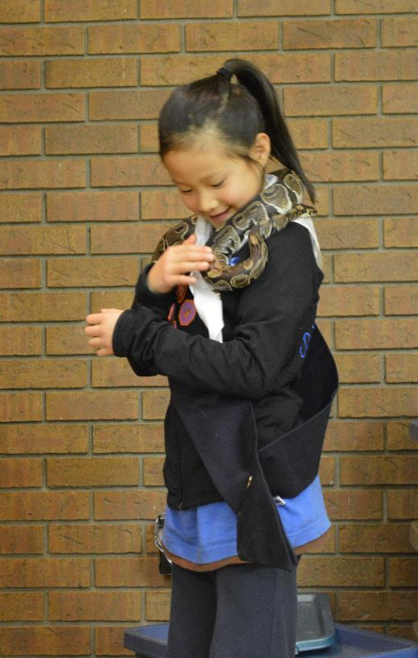
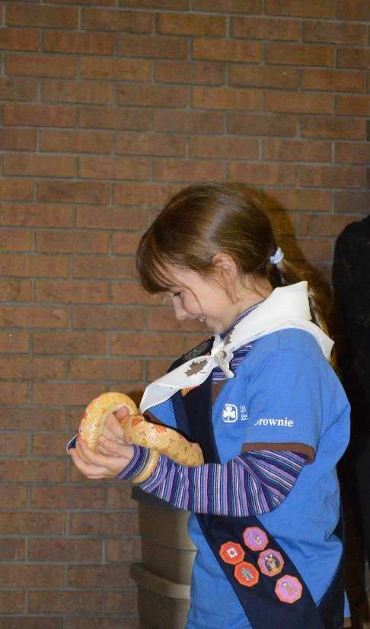
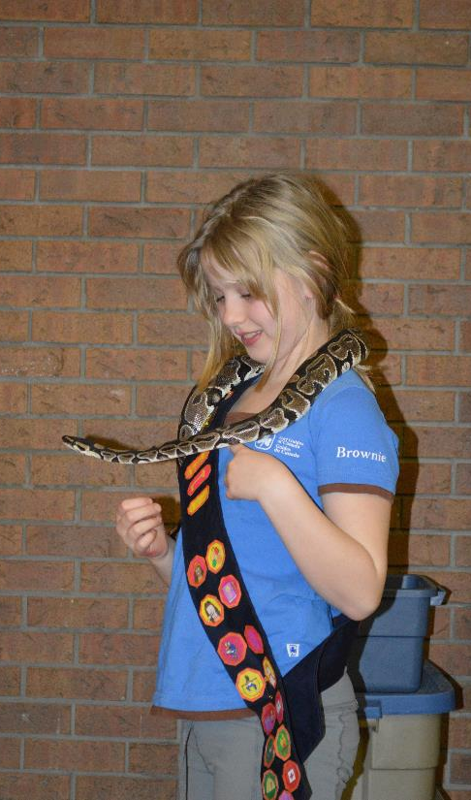
NOTE:
To change images on this slide, select a picture and delete it. Then click the Insert Picture icon
in the placeholder to insert your own image.
Snake Scarves

Slide 17
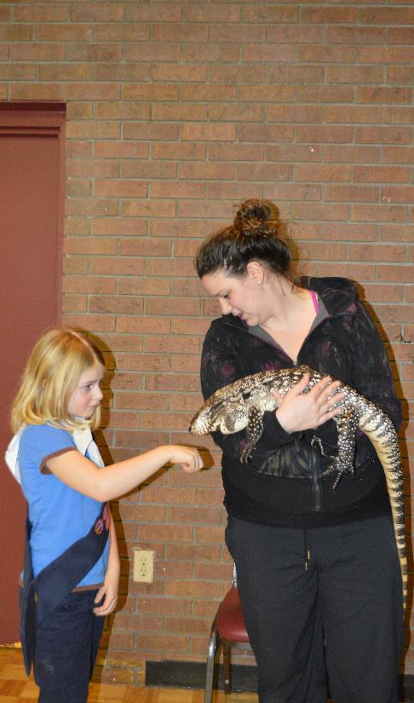
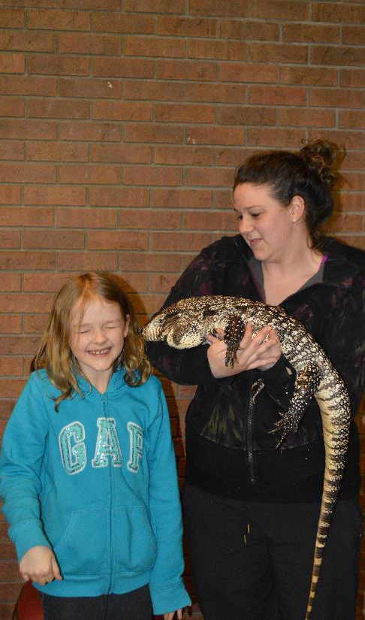
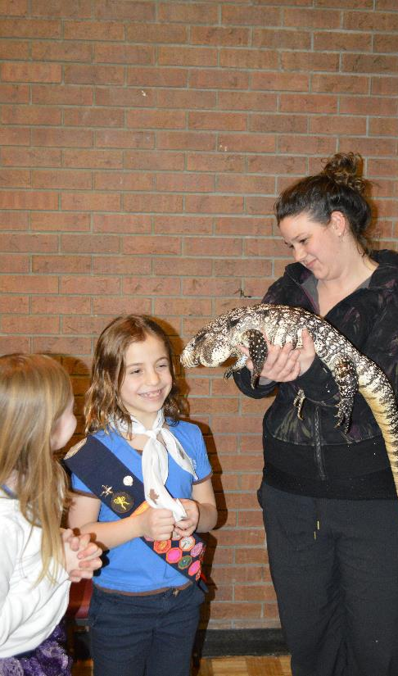
NOTE:
To change images on this slide, select a picture and delete it. Then click the Insert Picture icon
in the placeholder to insert your own image.
Kisses from “Oreo”

Slide 18
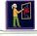
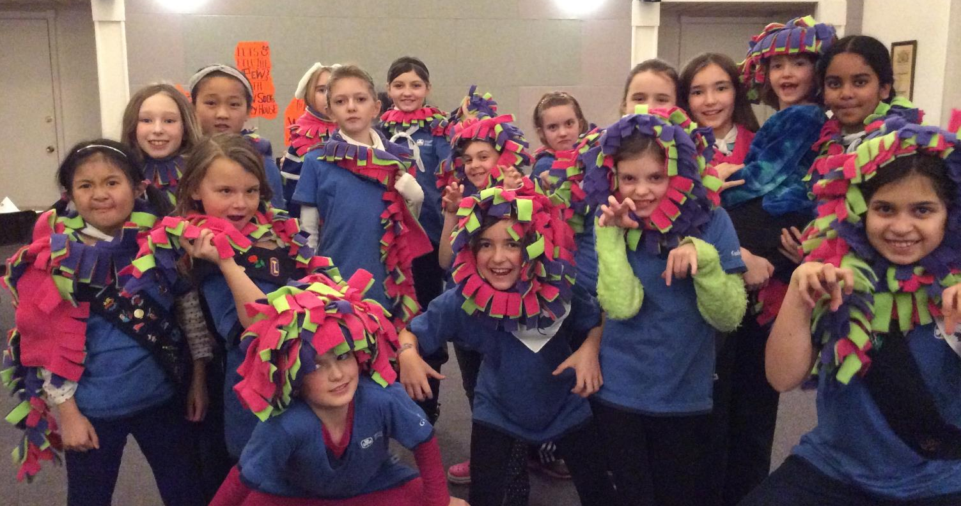
Discover Your Creativity - Making Scarves
1st Waterdown Guides
NOTE:
To change images on this slide, select a picture and delete it. Then click the Insert Picture icon
in the placeholder to insert your own image.

Slide 19
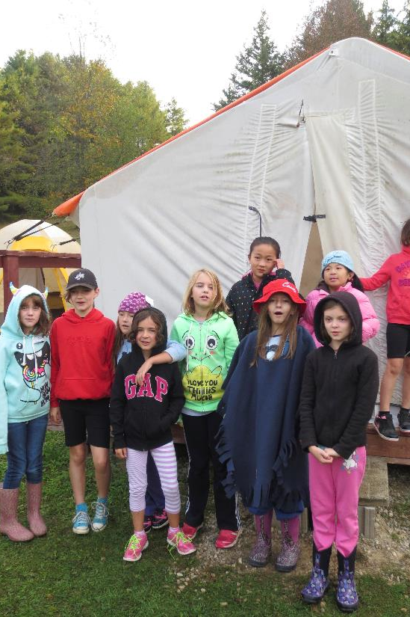
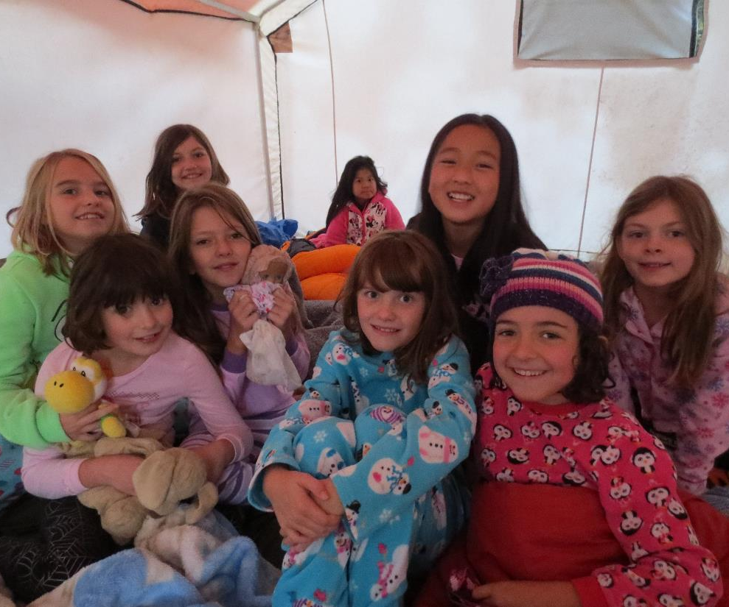
NOTE:
To change images on this slide, select a picture and delete it. Then click the Insert Picture icon
in the placeholder to insert your own image.
Camp Wyoka

Slide 20
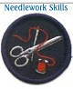
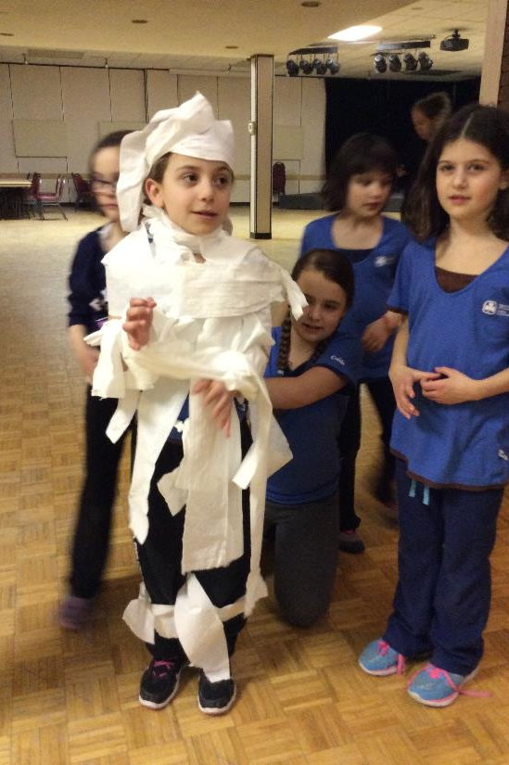
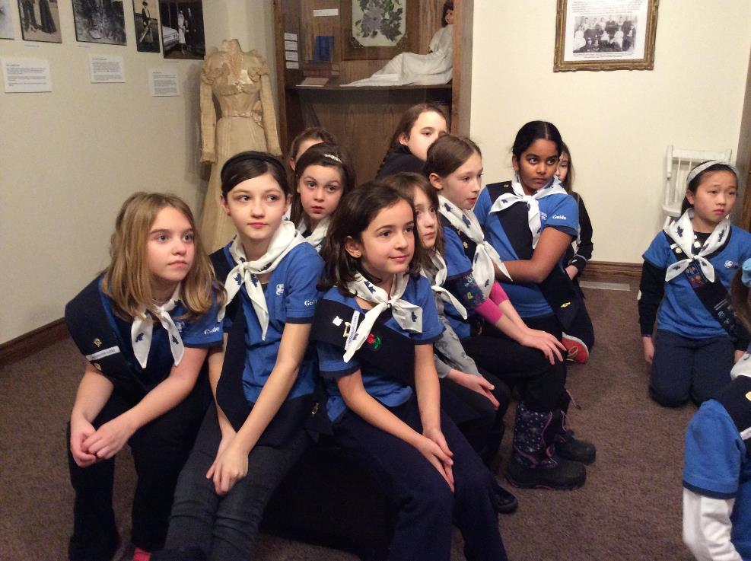
NOTE:
To change images on this slide, select a picture and delete it. Then click the Insert Picture icon
in the placeholder to insert your own image.
Brownies Visit Guides for Zumba and games
Needlework at Ireland House

Slide 21
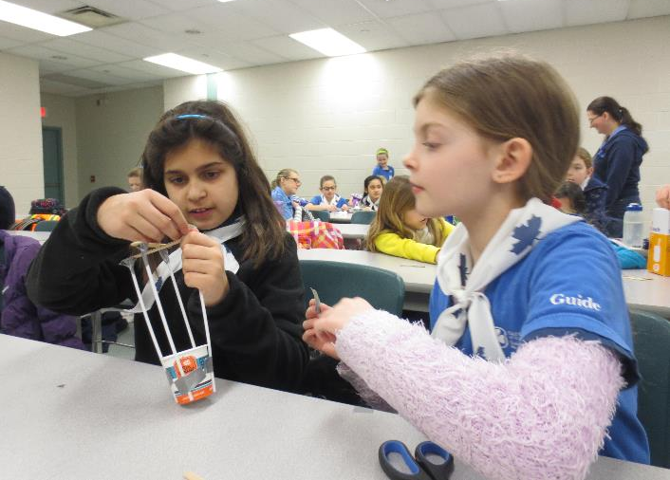
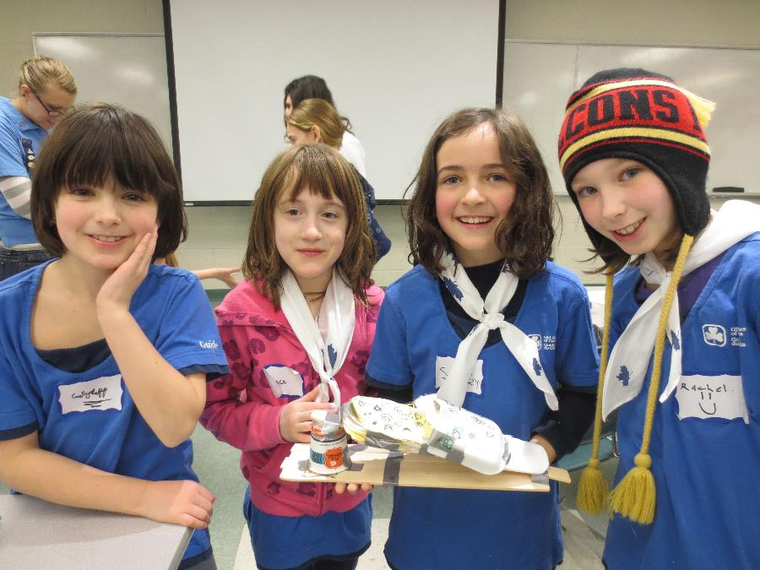

NOTE:
To change images on this slide, select a picture and delete it. Then click the Insert Picture icon
in the placeholder to insert your own image.
Girl Guide Day at McMaster

Slide 22


NOTE:
To change images on this slide, select a picture and delete it. Then click the Insert Picture icon
in the placeholder to insert your own image.
Sleeping in Covered Wagons at Circle Square Ranch

Slide 23




NOTE:
To change images on this slide, select a picture and delete it. Then click the Insert Picture icon
in the placeholder to insert your own image.
Horseback Riding and Archery at Circle Square Ranch

Slide 24


NOTE:
To change images on this slide, select a picture and delete it. Then click the Insert Picture icon
in the placeholder to insert your own image.
Thinking Day Ceremony
Sleepover at Knox Church

Slide 25






Cookie Selling
NOTE:
To change images on this slide, select a picture and delete it. Then click the Insert Picture icon
in the placeholder to insert your own image.

Slide 26




Bridging Events
NOTE:
To change images on this slide, select a picture and delete it. Then click the Insert Picture icon
in the placeholder to insert your own image.
Skating at Carlisle Arena

Slide 27



NOTE:
To change images on this slide, select a picture and delete it. Then click the Insert Picture icon
in the placeholder to insert your own image.
Sparks and Brownies

Slide 28


NOTE:
To change images on this slide, select a picture and delete it. Then click the Insert Picture icon
in the placeholder to insert your own image.
1st Waterdown Sparks
1st Waterdown Guides

Slide 29



NOTE:
To change images on this slide, select a picture and delete it. Then click the Insert Picture icon
in the placeholder to insert your own image.
Brownies and Guides

Slide 30





NOTE:
To change images on this slide, select a picture and delete it. Then click the Insert Picture icon
in the placeholder to insert your own image.
Sparks and Brownies Hike
at Joe Sam’s Park

Slide 31


See you next year… to blossom together through Guiding!

